Slide 1
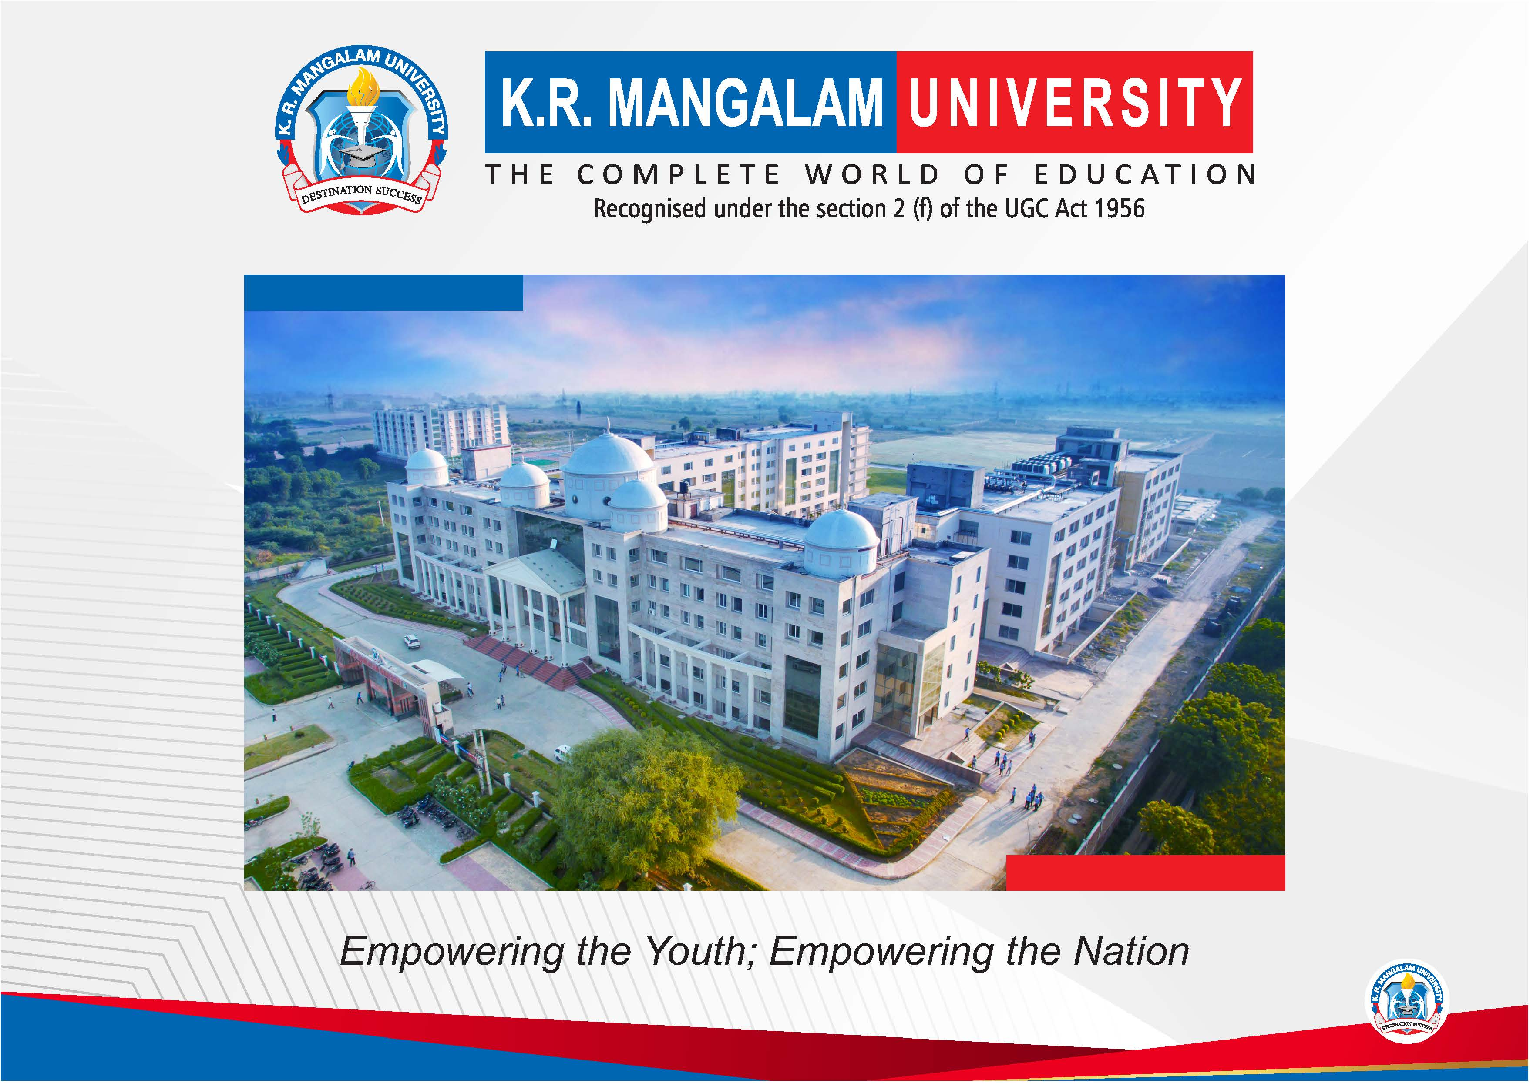

Slide 2


Smart Waste Management System Using IOT
Pre-Final Year Project Synopsis
Submitted by
ROLL | NAME
2401730091 | Tushar
2401730150 | Devesh Kumar
2401730151 | Komatireddy Reddy
2401730173 | Piyush Sharma
2401730205 | Yashraj Pahuja
Faculty Mentor: Dr. Meenu
Notes:
New Courses replaced with New Programmes

Slide 3

Project Overview
Conventional waste management systems rely on fixed collection routes and manual waste segregation, resulting in inefficient operations, unnecessary fuel consumption, higher carbon emissions, and poor recycling efficiency. Garbage trucks often collect waste from partially filled bins, while mixed waste limits effective recycling.
EcoRoute Pro is an AI and IoT based smart waste management system that addresses these challenges using real-time data and intelligent decision-making. The system uses smart bins that segregate waste at the source into biodegradable, plastic, and metal categories, measure the weight of each waste type, and reward users with eco-credits at a rate of ₹0.10 per 10 grams.
Sensor data from the bins is used to dynamically decide which bins require collection and to generate optimized collection routes that minimize travel distance, fuel usage, and collection time. The segregated waste is further routed to appropriate recycling and processing facilities, enabling efficient recycling and supporting a sustainable, circular waste management model for smart cities.
Notes:
New Courses replaced with New Programmes

Slide 4
Specific Objectives
To design and implement IoT-enabled smart garbage bins capable of segregating waste into biodegradable, plastic, and metal categories at the source.
To accurately measure the weight and fill level of each waste category using embedded sensors for real-time monitoring.
To develop a digital eco-credit system that rewards users at a fixed rate of ₹0.10 per 10 grams for proper waste segregation and disposal.
To collect and transmit real-time sensor data from smart bins to a centralized application using wireless communication.
To identify priority bins for collection using threshold-based decision logic to prevent unnecessary truck visits.
To calculate accurate distances between bins using geospatial algorithms for realistic routing and fuel estimation.
To optimize garbage truck routes using heuristic pathfinding techniques in order to minimize travel distance, fuel consumption, and collection time.
To visualize bin status, optimized routes, and performance metrics through an interactive GIS-based dashboard.
To ensure proper routing of segregated waste to suitable recycling and processing facilities.
To reduce operational cost, environmental impact, and carbon emissions through intelligent waste management.
Notes:
New Courses replaced with New Programmes

Slide 5
Key Features
IoT-enabled smart garbage bins with automatic segregation of biodegradable, plastic, and metal waste at the source.
Real-time measurement of waste weight and fill level using integrated sensors for accurate monitoring.
Digital eco-credit reward system providing ₹0.10 per 10 grams of properly segregated waste to encourage citizen participation.
Real-time data transmission from bins to a centralized application using wireless connectivity.
Intelligent bin selection using threshold-based decision logic to avoid unnecessary garbage truck visits.
Optimized garbage collection routes using geospatial distance calculations and heuristic pathfinding algorithms.
GIS-based visualization of bin locations, fill levels, and collection routes through an interactive dashboard.
Efficient routing of segregated waste to appropriate recycling and processing facilities.
Reduction in fuel consumption, collection time, operational cost, and carbon emissions.
Scalable architecture suitable for smart city and large-scale urban deployment.
Notes:
New Courses replaced with New Programmes

Slide 6
Project Usecases & Scope
Use Cases
Smart garbage collection in urban residential areas using real-time bin monitoring.
Optimized routing of garbage trucks based on actual waste levels to prevent unnecessary trips.
Source-level waste segregation and weighing for improved recycling efficiency.
Citizen participation through eco-credit rewards for responsible waste disposal.
Monitoring and management of waste collection operations through a centralized dashboard.
Data-driven decision support for municipal authorities and waste management agencies.
Scope
Deployment of IoT-enabled smart bins with automatic segregation and weight measurement.
Real-time data acquisition and processing for waste monitoring and route optimization.
Integration of geospatial algorithms for accurate distance calculation and routing.
Visualization of collection routes, bin status, and performance metrics.
Support for biodegradable, plastic, and metal waste streams.
Scalable design suitable for smart cities and large urban environments.
Future scope includes machine learning-based waste prediction, mobile applications, and carbon credit integration.
Notes:
New Courses replaced with New Programmes

Slide 7
Prototype/Project Flow diagram/Architecture
The EcoRoute Pro system follows a layered architecture that integrates IoT hardware, data processing, intelligent optimization, and visualization.
1. Smart Bin Layer (Data Acquisition) IoT-enabled smart bins collect real-time data using sensors. Waste is segregated at the source into biodegradable, plastic, and metal compartments. Load cells measure the exact weight of each waste type, while ultrasonic sensors track fill levels. User identification is handled through QR or NFC scanning.
2. Communication Layer Sensor data including waste type, weight, fill level, bin location, and user ID is transmitted wirelessly from the ESP32 controller to the cloud or centralized server in structured JSON format.
3. Processing & Intelligence Layer The backend application processes incoming data and applies decision logic to identify bins that require collection. Geospatial distance calculations are performed, followed by route optimization using heuristic algorithms to generate the most efficient collection path.
4. Analytics Layer The system computes operational metrics such as total distance traveled, fuel consumption, time required, and environmental impact reduction. User eco-credits are calculated based on waste type and weight.
5. Visualization & Application Layer An interactive GIS-based dashboard displays bin status, optimized routes, performance metrics, and eco-credit summaries for users and administrators.
6. Recycling & Processing Layer Segregated waste is routed to appropriate composting, recycling, or recovery facilities, ensuring efficient recycling and minimal environmental impact.
Notes:
New Courses replaced with New Programmes

Slide 8
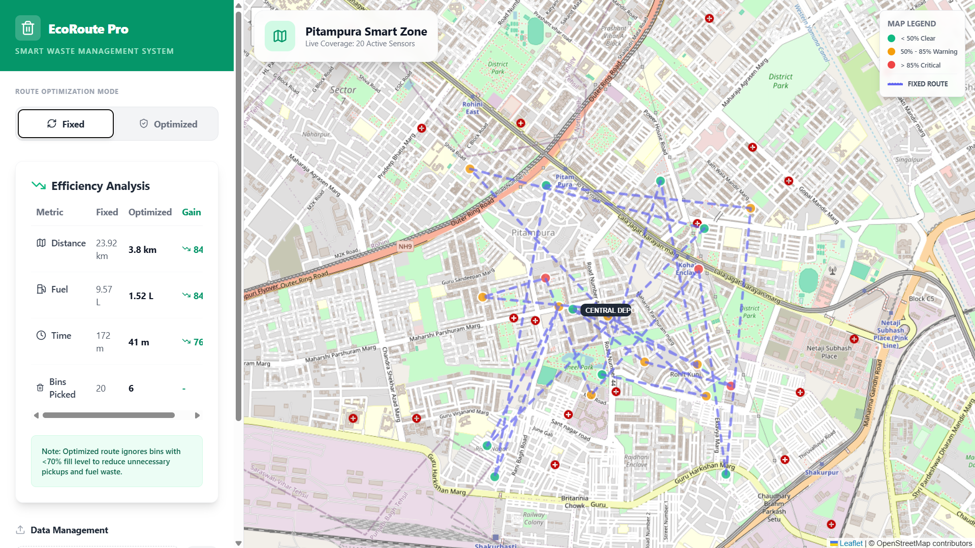
Before

Slide 9
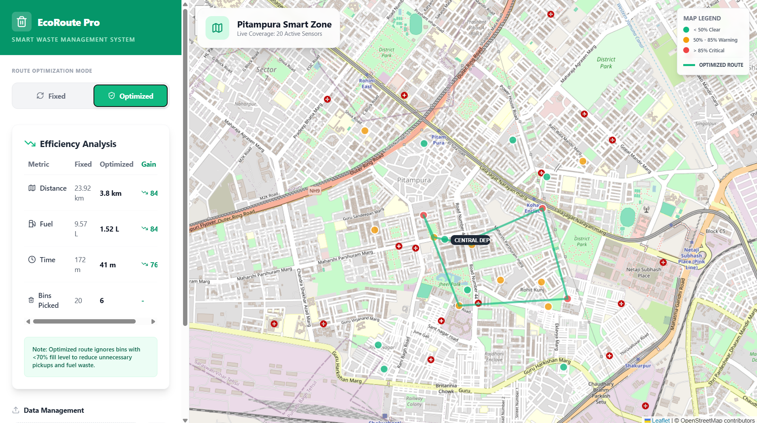
After

Slide 10
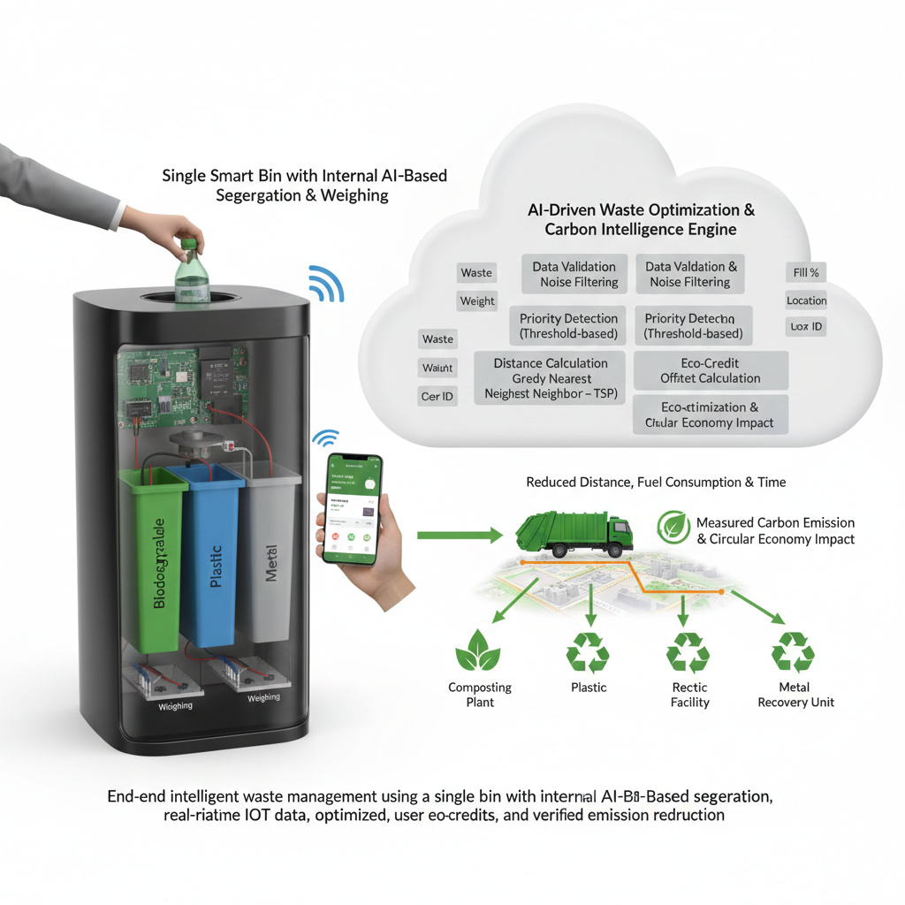
Notes:
New Courses replaced with New Programmes

Slide 11
Data & Resources
The proposed system relies on a combination of real-time sensor data, spatial data, and system-defined parameters to enable intelligent waste segregation, optimized collection, and sustainability analytics.
1. Real-Time IoT Data
Data is continuously generated at the smart bin level using embedded sensors:
Fill-Level Data: Ultrasonic sensor readings to determine bin occupancy percentage.
Weight Data: Load cell measurements to quantify waste deposited, used for eco-credit allocation and carbon estimation.
Waste Type Classification: Internally segregated waste categories (biodegradable, plastic, metal) identified through system logic.
Environmental Data: Gas and temperature sensors for safety and waste condition monitoring.
Location Data: GPS coordinates of each bin for spatial mapping and route optimization.
User Interaction Data: QR/NFC-based user identification linked to deposited waste and earned eco-credits.
2. Spatial & Geographical Data
Latitude–Longitude Coordinates: Used to map bin locations within the city.
Road Network & Map Tiles: OpenStreetMap (OSM) data for GIS-based visualization and route plotting.
Depot Location: Fixed reference point for waste collection vehicle routing.
Notes:
New Courses replaced with New Programmes

Slide 12
Data & Resources
3. System-Defined Parameters & Constants
To ensure realistic simulation and analytics, the system uses predefined operational constants:
Average garbage truck speed (urban conditions)
Fuel consumption per kilometer
Time required per bin collection
Eco-credit conversion rate (e.g., 10 grams = ₹0.10 EcoCredits)
Carbon emission factors per unit distance and fuel usage
4. Data Processing & Storage Resources
Edge Processing: Initial data validation and sensor noise filtering at the ESP32 level.
Cloud / Backend Storage: Structured storage of historical bin data, route logs, and user eco-credit records.
Data Formats: JSON-based data exchange for scalability and interoperability.
5. Software & Computational Resources
Routing Algorithms: Threshold filtering, Haversine distance calculation, and Greedy Nearest Neighbor (TSP heuristic).
Visualization Tools: GIS maps and dashboards for route comparison, performance metrics, and sustainability impact.
Analytics Engine: Computes distance savings, fuel reduction, time efficiency, and carbon emission reduction.
6. External Resources & Standards
Open-source mapping platforms (OpenStreetMap)
Smart City and waste management benchmarks
Standard carbon emission coefficients for transportation
Notes:
New Courses replaced with New Programmes

Slide 13
Methodology
Smart Waste Input Single IoT-enabled bin automatically segregates waste into biodegradable, plastic, and metal compartments and records deposited weight.
Real-Time Data Capture Sensors collect fill level, weight, gas status, location, and user identity.
Data Validation Noise filtering and normalization ensure reliable sensor data.
Decision Logic Threshold-based filtering selects only priority bins for collection.
Distance Estimation Accurate spherical distances are computed using the Haversine formula.
Route Optimization Greedy Nearest Neighbor heuristic generates an efficient collection route.
Analytics & Incentives Fuel, time, and carbon reduction are calculated, and eco-credits are awarded to users.
Visualization Optimized routes, system performance, and user credits are displayed on a GIS dashboard.
Notes:
New Courses replaced with New Programmes

Slide 14
Expected Results & Impact
Expected Results
Reduced Collection Distance Optimized routing minimizes unnecessary travel by avoiding low-priority bins.
Fuel and Time Savings Fewer kilometers per collection cycle result in lower fuel consumption and faster operations.
Improved Collection Efficiency Higher waste collected per trip due to threshold-based bin selection.
Accurate Waste Segregation Automated internal segregation improves recycling quality and reduces contamination.
Real-Time Monitoring Continuous visibility of bin status, route progress, and system performance.
User Eco-Credit Generation Users receive measurable rewards based on actual waste weight deposited.
Impact
Environmental Impact Reduced carbon emissions through optimized routing and increased recycling.
Operational Impact Lower operational costs for municipalities and waste management agencies.
Behavioral Impact Eco-credit incentives encourage responsible waste disposal and segregation.
Urban Sustainability Enables scalable, data-driven smart city waste management infrastructure.
Notes:
New Courses replaced with New Programmes

Slide 15
Project Timeline
Phase | Activity Description | Duration
Stage | Milestone | Key Deliverables
Stage 1 | Concept & Feasibility | Problem definition, literature review, system feasibility, requirement finalization
Stage 2 | System Architecture | Complete system design, data flow diagrams, hardware and software architecture
Stage 3 | Hardware Prototype | Smart bin prototype, sensor integration, ESP32 firmware, power management
Stage 4 | Core Algorithm Development | Threshold filtering, Haversine distance computation, route optimization (TSP heuristic)
Stage 5 | Analytics & Incentive Engine | Fuel, time, carbon estimation models, eco-credit calculation logic
Stage 6 | Visualization & Application | GIS-based dashboard, optimized route display, user eco-credit interface
Phase | Activity | Duration
Phase 1 | Requirement Analysis | 1 Week
Phase 2 | Hardware Integration | 2 Weeks
Phase 3 | Software Development | 3 Weeks
Phase 4 | Algorithm Implementation | 2 Weeks
Phase 5 | Testing & Evaluation | 2 Weeks
Phase 6 | Documentation & Review | 1 Week
Notes:
New Courses replaced with New Programmes

Slide 16
THANK YOU

